Slide 1
John Lewis Invictus Academy
Budget Feedback Meeting
Ramon Garner, Principal
February 13, 2023

Slide 2
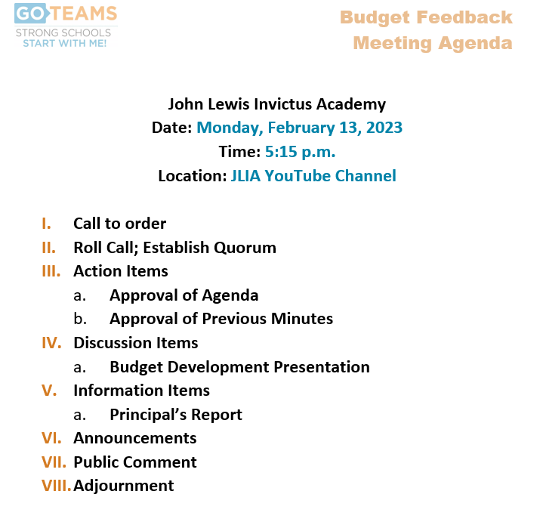
agenda

Slide 3
Norms
This is a meeting of the GO Team. Only members of the team may participate in the discussion. Any members of the public present are here to quietly observe.
We will follow the agenda as noticed to the public and stay on task.
We invite and welcome contributions of every member and listen to each other.
We will respect all ideas and assume good intentions.

Slide 4

GO Team Budget Development Process
YOUR SCHOOL STRATEGIC PLAN…
is your roadmap and your role.
It is your direction, your priorities, your vision, your present, your future.
Step 1: Data Review
Step 2: Strategic Plan Review
Step 3: Budget Parameters
(Strategic Priorities)
Step 4: Budget Choices
Notes:
Today I will provide an overview of the budget allocations for FY23. We will begin the work of funding the strategic priorities we agreed upon during our strategic review meeting. (IF YOU HAVE NOT DECIDED ON YOUR PRIORITIES, YOU WILL SAY – WE WILL DECIDE ON OUR PRIORITIES AND THEN DISCUSS ALLOCATING FUNDS TO ADDRESS THOSE PRIORITIES).

Slide 5
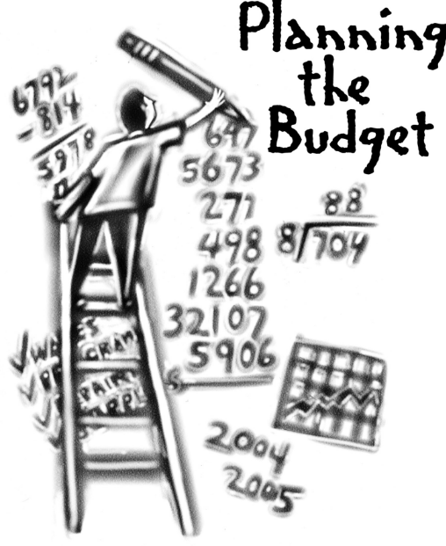
Overview of FY ‘24 GO Team Budget Process
Step 1 Review and Update Strategic Plan and Rank Strategic Priorities
By end of Fall Semester
Step 6 Principals: HR Staffing Conferences Begin
Late February – Early March
Step 3 GO Team Initial Budget Session: Allocation
January 31 January 24 – early February
Step 7 GO Team Final Budget Approval Meeting
March 14 Budgets Approved by March 17
Step 5
GO Team Feedback Session: Draft Budget Presented & Discussed February 13 February – multiple meetings, if necessary
Step 4 Principals: Associate Supt. Discussions and Review
February (supports needed, specific challenges, coaching)
Step 2 Principals: Workshop FY 24 Budget
January 24
GO Teams are encouraged to have ongoing conversations

Slide 6
Budget Feedback Meetings
What
The GO Team feedback session(s) should be scheduled for the principal to provide an overview of the school’s draft budget for the GO Team members and the general public.
Why
This meeting provides an opportunity for GO Teams to discuss how the school’s budget has been allocated to support the programmatic needs and key strategic priorities.
When
Meetings must be held in February before staffing conferences. May be combined with the allocation meeting (as needed), if the GO Team has completed strategic plan updates and ranked strategic priorities.
Notes:
Looking for general consensus prior to Staffing Conferences

Slide 7

FY24 Budget Parameters
FY24 School Priorities | Rationale
Improve students’ mastery of core content knowledge (ELA, Math, Science and Social Studies) | A majority of scholars arrive at JLIA reading below grade level & with gaps in both their literacy and math proficiency.
Close the student achievement gap with General Education Students and Students with Disabilities | “Lagging achievement evidenced as early as fourth grade appears to be a powerful predictor of rates of high school and college graduation, as well as lifetime earnings” (McKinsey and Company, The Economic Impact of the Achievement Gap in America’s Schools, 2009).
Implement STEAM enriched curriculum to drive interdisciplinary and project-based teaching and learning approaches. | Atlanta is bustling with economic opportunities and a growing job market. We aspire for our students to have the type of educational experiences and success at JLIA that will position them not only to graduate high school, but to go onto college and emerge with the qualifications needed to land the types of high-paying jobs that will be waiting for them in their community.
Prepare all students to have the essential life skills to be self-aware, collaborative, and accepting diversity. | A majority of JLIA scholars are impacted by the social, emotional, behavioral, & health determinants of poverty that keep them from thriving academically in school.
Notes:
Review the priorities that the GO Team has developed and the rationale for these priorities. Feel free to copy this slide if you have more than 3 priorities to account for.

Slide 8
FY24 Budget Parameters
FY24 School Priorities | Rationale
Prepare and develop knowledgeable staff focused on quality teaching. | JLIA teachers need PD, coaching, and collaborative planning (PLC) support to equip them with the knowledge, skills, and mindsets necessary to ensure that every student has access to grade-appropriate assignments, strong instruction, deep engagement, and teachers with high expectations, every day, in every class—regardless of their race, ethnicity, or any other part of their identity.
Build teacher capacity in core content areas (ELA, Math, Science and Social Studies). | JLIA teachers need PD, coaching, and collaborative planning (PLC) support to equip them with the knowledge, skills, and mindsets necessary to ensure that every student has access to grade-appropriate assignments, strong instruction, deep engagement, and teachers with high expectations, every day, in every class—regardless of their race, ethnicity, or any other part of their identity.
Recommend high-quality staff for vacant positions. | JLIA teachers need PD, coaching, and collaborative planning (PLC) support to equip them with the knowledge, skills, and mindsets necessary to ensure that every student has access to grade-appropriate assignments, strong instruction, deep engagement, and teachers with high expectations, every day, in every class—regardless of their race, ethnicity, or any other part of their identity.
Notes:
Review the priorities that the GO Team has developed and the rationale for these priorities.

Slide 9
FY24 Budget Parameters
FY24 School Priorities | Rationale
Create a culture of high expectation for academic scholarship, civic responsibility and service for students, staff, and families. | In the classroom, we not only strive to close gaps, but to create a learning environment where students are positioned to thrive academically through daily exposure to rigorous and relevant content with practical, real-world applications.
Ensure systems and resources are aligned to school priorities. | In the classroom, we not only strive to close gaps, but to create a learning environment where students are positioned to thrive academically through daily exposure to rigorous and relevant content with practical, real-world applications.
Build systems and resources to support STEAM implementation. | In the classroom, we not only strive to close gaps, but to create a learning environment where students are positioned to thrive academically through daily exposure to rigorous and relevant content with practical, real-world applications.
Notes:
Review the priorities that the GO Team has developed and the rationale for these priorities.

Slide 10
Descriptions of Strategic Plan
Breakout Categories
Priorities: FY24 funding priorities from the school’s strategic plan, ranked by the order of importance.
APS Five Focus Area: What part of the APS Five is the priority aligned to?
Strategies: Lays out specific objectives for schools improvement.
Request: “The Ask” What needs to be funded in order to support the strategy?
Amount: What is the cost associated with the Request?

Slide 11
FY24 Strategic Plan Break-out
Priorities | APS FIVE Focus Area | Strategies | Requests | Amount
Prepare and develop knowledgeable staff focused on quality teaching. Recommend high–quality staff for vacant positions. | Curriculum + Instruction | Implement intentional vertical and horizontal alignment collaboration throughout school and cluster | Maintain current staffing position allocations. | $7, 968,491
Improve students' mastery of core content knowledge (ELA, Math, Science, and Social Studies). | Curriculum + Instruction | Implement Standards-Based practices Build teacher capacity around instructional best practices through collaborative planning and the coaching cycle | Maintain current staffing position allocations. | $7, 968,491
Implement STEAM enriched curriculum to drive interdisciplinary and project-based teaching and learning approaches. | Signature Programming | Provide targeted professional learning opportunities focused on the implementation of standards and STEAM Implement integrated, project and problem-based learning Projects | Maintain current staffing position allocations. | $7, 968,491
Create a culture of high expectation for academic scholarship, civic responsibility, and service for students, staff, and families. | Whole Child + Intervention | Communicate Scholar expectations Implement a school -wide behavior plan | Purchase a Behavior Specialist | $109,664
Notes:
For the next few slides, I will show you how I have allocated the budget to support our strategic priorities.
Based on our strategic priorities and funds we received, here is a break-out of the priorities, which focus area it addresses, the strategies that will be implemented, the purchase request, which funding source was used and the amount.

Slide 12
Plan for FY24 Leveling Reserve
Priorities | APS FIVE Focus Area | Strategies | Requests | Amount
Ensure systems and resources are aligned to school priorities. | Data | Build and align systems and resources to identify and address root cause to promote social and academic growth | Maintain current staffing allocations and designate reserves to prevent staffing impacts from leveling. | $117,142
Notes:
For the next few slides, I will show you how I have allocated the budget to support our strategic priorities.
Based on our strategic priorities and funds we received, here is a break-out of the priorities, which focus area it addresses, the strategies that will be implemented, the purchase request, which funding source was used and the amount.

Slide 13
Plan for FY24 Title I Holdback & Family Engagement Funds
Priorities | APS FIVE Focus Area | Strategies | Requests | Amount
Create a culture of high expectation for academic scholarship, civic responsibility, and service for students, staff, and families. | Whole Child + Intervention | Use wrap -around services to assist students and their families with emotional mental and physiological needs. Utilize resources to build and strengthen school -home relationships | Fund family engagement activities including Parent Data Nights, Grade Level and Subject Parent Workshops and PBL and STEAM community showcases | $15,000
Title I Holdback 10% of Title I designation | Data |  |  | $59,400
Notes:
For the next few slides, I will show you how I have allocated the budget to support our strategic priorities.
Based on our strategic priorities and funds we received, here is a break-out of the priorities, which focus area it addresses, the strategies that will be implemented, the purchase request, which funding source was used and the amount.

Slide 14
Plan for FY24 CARES Allocation
Priorities | APS FIVE Focus Area | Strategies | Requests | Amount
Prepare all students to have the essential life skills to be self-aware, collaborative, and accepting diversity. | Whole Child + Intervention | Implement guided reading and close reading to improve comprehension | Purchase a reading teacher | $97,860
Create a culture of high expectation for academic scholarship, civic responsibility, and service for students, staff, and families. | Whole Child + Intervention | Communicate Scholar expectations Implement a school -wide behavior plan | Purchase a non-instructional para | $46,696
Improve students' mastery of core content knowledge (ELA, Math, Science, and Social Studies). Close the student achievement gap with General Education Students and Students with Disabilities. | Curriculum + Instruction | Provide remediation and acceleration as indicated by data Use flexible learning days to remediate/ accelerate skills based on grade level data to guide instructional practices | Fund staffing and transportation resources to execute Afterschool Tutorial and Saturday School opportunities | $50,000
Prepare and develop knowledgeable staff focused on quality teaching. Build teacher capacity in core content areas (ELA, Math, Science, and Social Studies). | Curriculum + Instruction | Provide targeted professional learning opportunities focused on the implementation of standards | Fund curriculum implementation coaches and consultants to | 90,000
Notes:
For the next few slides, I will show you how I have allocated the budget to support our strategic priorities.
Based on our strategic priorities and funds we received, here is a break-out of the priorities, which focus area it addresses, the strategies that will be implemented, the purchase request, which funding source was used and the amount.

Slide 15
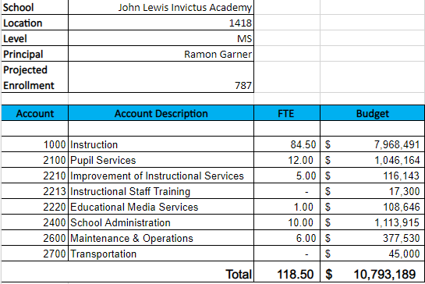
Budget by Function
*Based on Current Allocation of School Budget
Notes:
I am passing out the definitions for these funding categories. You will see what makes up each category. Although the school’s total budget amount will not change, allocation per function may change depending on our conversations and school needs.

Slide 16
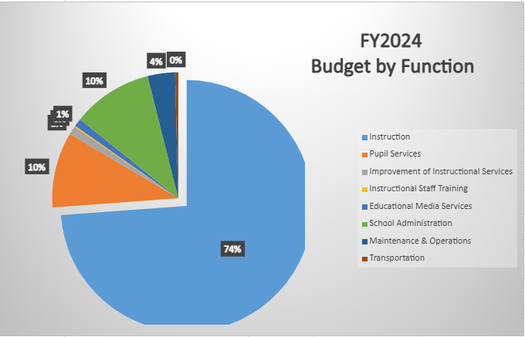
Budget by Function
*Based on Current Allocation of School Budget
Notes:
Explain the pie chart and allocations

Slide 17
Questions for the GO Team to Consider and Discuss
Are our school’s priorities (from your strategic plan) reflected in this budget?
Are new positions and/or resources included in the budget to address our major priorities?
Do we know (as a team) the plan to support implementation of these priorities beyond the budget (ex. What strategies will be implemented)?
What tradeoffs are being made in order to support these priorities?
How are district and cluster priorities reflected in our budget?
Cluster priorities- what staff, materials, etc. are dedicated to supporting our cluster’s priorities?
Signature programs- what staff, materials, etc. are dedicated to supporting our signature program?
Are there positions our school will share with another school, i.e. nurse, counselor?
Notes:
CHAIR - Our final task for today! Here are questions that we need to consider to ensure we have a good working draft budget. Let’s walk through them together.

Slide 18
Where We’re Going?
Our next meeting is the Budget Approval Meeting
Why:
Principals will present the final budget recommendations for GO Team approval.
What:
During this meeting we will review the budget, which should be updated based on feedback from the staffing conference, Associate Superintendents, and key leaders. After review, our GO Team will need to take action (i.e., vote) on the FY24 Budget.
When:
March 14, 2023.
All approval meetings must be held after staffing conferences. Budgets must be approved by March 17th.

Slide 19
agenda

Slide 20
Thank you

